Slide 1
Category review: Chips
June 2020
Retail Analytics
By: Murong (Sophie) Cui
Brand note: If client logo is not required, use alternate title page layout right click slide thumbnail > Layout > Title

Slide 2
Notes:
To view Privacy video explaining how important data privacy is to Quantium, please click here: https://www.youtube.com/watch?v=Zq1QDAkoRzU
or here Q:\Company Reference\Brand & Design\Brand videos\Q Privacy.mp4
At Quantium, we believe that data is the behavioural footprint of humanity and that it has to be treated with the utmost care and responsibility.
Histories, attitudes, indeed lives are stored within it in ways that aren’t always apparent – and that’s what makes its potential so powerful.
To work with it responsibly, sensitively, we set ourselves the highest data privacy protection and governance standards.
We have spent 17 years perfecting privacy-by-design and secure-by-design principles. Central to this is not holding any personally identifiable information about people –
we neither receive it, and put the necessary protections in place to be unable to decipher it.
Every aspect of handling data is safeguarded: from its de-identification, to its encryption – data security is paramount and of the highest grade.
We pride ourselves on gaining the trust of iconic organisations around the world through years of securely working with their data,
and in turn the trust that builds with their stakeholders.

Slide 3
Executive summary
01
Customer Analytics
Top 3 Total Sales are contributed by Budget – Older Families,
Mainstream – Young Singles/Couples,
Mainstream – Retirees
- Older Families have highest customer value regarding sales per capita and number of chips bought
- Mainstream – Young Singles/Couples is the largest customer segmentation and willing to buy more unit price and bigger pack size.
02
Uplift Test
We found control store 233, 155, 237 for trial stores 77, 86, 88 respectively.
- The results for trial store 77 and 88 during the trial period (Feb 2019 – Apr 2019) show a significant different in the at least two of the three trial months
- The trial was different in trial store 86, and shows a significant increase in sales

Slide 4
01
Category

Slide 5
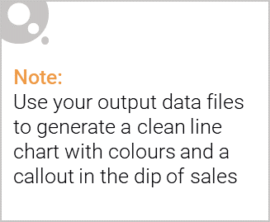
Mainstream – Young Singles/Couples is our
Target Customer Segment
No.1 in Unit Price of Chip Bought
No.2 in Total Sales
No.1 in Number of Customers

Slide 6
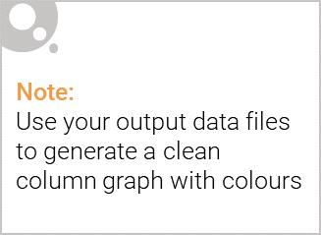
Popular Chip Brands by Customer Segment
Kettle is the best selling brand, especially in Mainstream-Young Singles/Couples

Slide 7
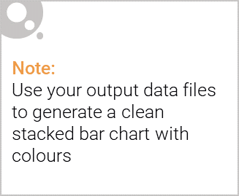
Editable (delete this)
Mainstream – Young Singles/Couples are willing to buy bigger size and higher unit price chips.

Slide 8
02
Trial store performance

Slide 9
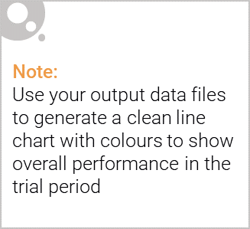
Explanation of the control store vs other stores
Determining metrics and data preparation
Metrics:
Data Preparation: Filtering data during the pre-trial period
Control Store Selection
Calculating how correlated the performance of each store is the trial store
Calculating a standardize metric based on the absolute difference between the trial store's performance of each store
Assessment of the Trail
Scaling the control store’s metrics to level similar to control for any differences between the two stores outside of the trial period
Conducting uplift test to determine whether the trial is successful.
- Monthly Number of Customers
- Monthly Overall Sales Revenues
Taking simple average of all the scores calculated using our function to create a composite score to rank on

Slide 10
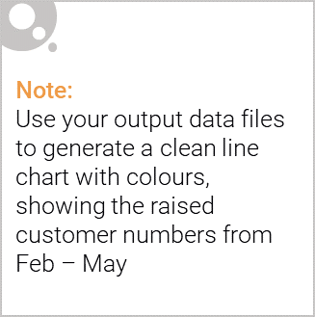
The trial was successful to increase total sales and number of customers
Store 77 VS Store 233
Store 86 VS Store 155
Store 88 VS Store 237

